Slide 1
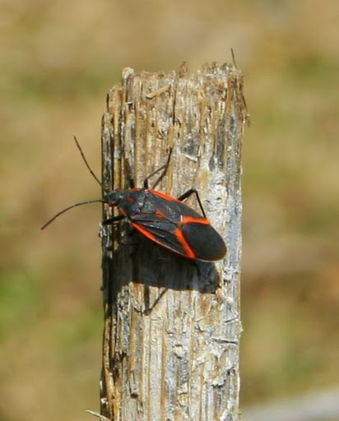
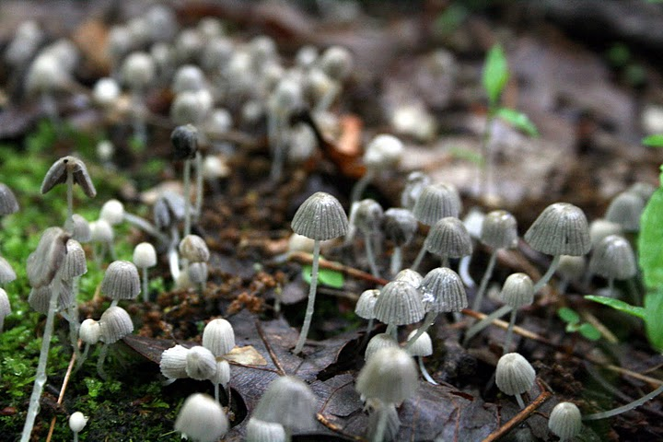
Dimensions of Biodiversity
NASA Carbon Cycle & Ecosystems Workshop
6 October 2011
George W. Gilchrist, NSF DEB

Slide 2
Dimensions of Biodiversity
A 10-year campaign to characterize the dimensions of biodiversity on Earth
http://www.nsf.gov/pubs/2011/nsf11518/nsf11518.pdf
Phylogenetic/
Taxonomic
Purpose:
Integrative approaches
Innovative concepts
Rapid advances
with an initial focus on areas where three key dimensions overlap
Target
Genetic
Functional

Slide 3
Dimensions of Biodiversity
FY2010
290 letters of intent
195 proposals reviewed in 2 panels
13 research awards and one joint U.S.-China IRCN
$23.7 M committed from 2 BIO Divisions, GEO and OPP
FY2011
116 proposals reviewed in 1 panel
11 research awards and one joint U.S.-China IRCN
$26.6 M committed from 4 BIO Divisions, GEO, and OISE
Panelist quotes
“This has pushed the community beyond business as usual.”
“[Dimensions] will accomplish in 10-15 years what would ordinarily take 50 years”

Slide 4
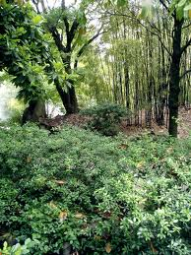
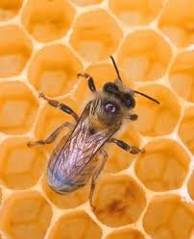
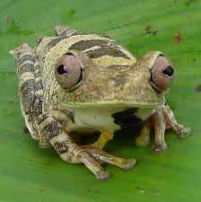
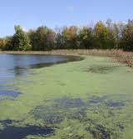
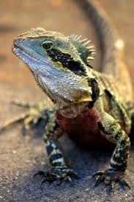
Dimensions of Biodiversity A Sampling of Funded Projects
1046113 | IRCN: Diversity and Forest Change: Characterizing functional, phylogenetic and genetic contributions to diversity gradients and dynamics in tree communities | Stuart Davies | Harvard
1046153 | Genomics, functional roles, and diversity of the symbiotic gut microbiotae of honey bees and bumble bees | Nancy Moran | Yale
1046408 | An integrative traits-based approach to predicting variation in vulnerability of tropical and temperate stream biodiversity to climate change | N. Leroy Poff | Colorado State
1046121 | Can evolutionary history predict how changes in biodiversity impact the productivity of ecosystems? | Bradley Cardinale | U. Michigan Ann Arbor
1046413 | Shedding light on viral dark matter - genetic, taxonomic, and functional diversity of coral reef viromes | Forest Rohwer | San Diego State
1136586 | Integrating genetic, taxonomic, and functional diversity of tetrapods across the Americas and through extinction risk | Thomas Brooks | NatureServe

Slide 5
Dimensions of Biodiversity
Streams of activity
2020 Goals
Research
An integrated understanding of the key but unknown dimensions of biodiversity on earth
Cyberinfrastructure
Informatics and infrastructure that support accessible, interoperable information capability for dimensions of biodiversity
Collections
Digitization of collections and enhanced physical infrastructure to link to cyberinfrastructure and leverage the enormous investments of the past
Workforce
A diverse, interdisciplinary, globally-engaged, scientific workforce capable of transforming and communicating our understanding of biodiversity on Earth
Synthesis
Scientific analyses and syntheses that generate and disseminate useful information for scientists, educators and decision makers
Approach:
Planning & Partnering
Base lining & synchronizing
Assessing progress
Aligning investments with emerging priorities

Slide 6
Coordinated Dimensions Activities:
Research
Workforce
Collections Digitization
Cyberinfrastructure
Analysis and Synthesis
Phylogenetic
Dimensions of Biodiversity
CONCEPTUAL TIMELINE
Genetic
Functional
2009
2010
2011
2012
2013
2014
2015
2016
2017
2018
2019
2020
PLANNING ACTIVITIES
PI Meeting
MID-POINT
CONFERENCE
PI Meeting
FINAL
CONFERENCE
FY2010 Solicitation
FY2011-2013 Research & Workforce Solicitation
FY2014-2016 Research & Workforce Solicitation
FY2017-2019 Research & Workforce Solicitation
CI & Data Mgmt
Guidelines Issued
CI & Data Mgmt
Guidelines Issued
CI & Data Mgmt
Guidelines Issued
FY2010 Digitization
FY2011-2013 Digitization
& Infrastructure Activities
FY2014-2016 Digitization
& Infrastructure Activities
FY2017-2019 Digitization
& Infrastructure Activities
Coordination and Partnerships: NSF, Interagency, International, NGO, Private Sector
2010 - 2011
Base lining Activity
2012 Progress Assessment
2014 Progress Assessment
2016 Progress Assessment
2018 Progress Assessment
2020
Base lining Activity
Base lining and Progress Assessment: Crowd –sourcing approaches
Notes:
Dynamic process
Assess and meet periodic milestones

Slide 7
Dimensions of Biodiversity
Recent and Upcoming Activities
Sept. 2010: Design Charette at NESCent, Durham, NC to inform a research agenda http://www.nescent.org/cal/calendar_detail.php?id=562
Oct. 2010: Cyberinfrastructure workshop at Univ. of Wisconsin http://lter.limnology.wisc.edu/cidimensions/
2010-11: Workshops in São Paulo, Brazil to discuss potential partnership opportunities
Summer 2011: Partnership meeting with National Natural Science Foundation of China and RCNs
Winter 2011: Initiation of Distributed Graduate Seminar base lining & synchronizing activity

Slide 8
Dimensions of Biodiversity
Developing Partnerships
NSF - China - the NSF and the National Natural Science Foundation of China (NSFC) initiated a successful multi-year partnership in FY2010 that resulted in an International Research Coordination Network being funded by the two agencies. http://nsf.gov/news/news_summ.jsp?cntn_id=117811&org=DEB&from=news. In 2012, the partnership will extend to the funding of research collaborations. Details are currently being finalized.
NSF – Brazil - the NSF and three Brazilian agencies are working toward active partnership for 2012: the Brazilian Federal Agency for Support and Evaluation of Graduate Education of the Federative Republic of Brazil (CAPES), Conselho Nacional de Desenvolvimento Científico e Tecnológico (CNPq) and the Fundação de Amparo à Pesquisa do Estado de São Paulo (FAPESP). Details are currently being finalized.

Slide 9
Dimensions of Biodiversity
The NSF-NASA Biodiversity Partnership
The NASA Biodiversity program in ESD centers on two key aspects:
Pattern: observed from satellites, airborne and seaborne platforms, and in situ surveys.
Process: ecological and geological drivers of the patterns of biodiversity.
Goals of joint NSF-NASA Dimensions partnership:
To promote innovative applications of remote sensing technologies with ground-based research to enhance the spatial aspect of Dimensions biodiversity research.
To foster new inter- and transdisciplinary partnerships
To train a new cohort of interdisciplinary scientists to sustain these efforts in the future.
Details:
NSF + NASA total funding up to $2 M per award, with NASA contributing to projects using remote sensing. Up to 60 months duration.
NASA total funding up to $2 M per year in 2012-2015.
Submission through NSF FastLane.
Review by NSF with NASA reviewers and program directors.
Deadline: mid-to-late March. Panels meet in May, funding decisions in June.

Slide 10
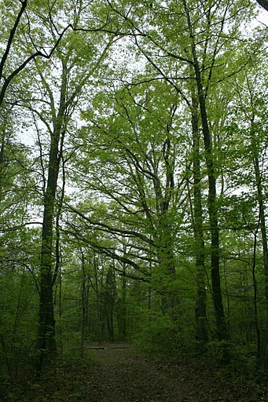
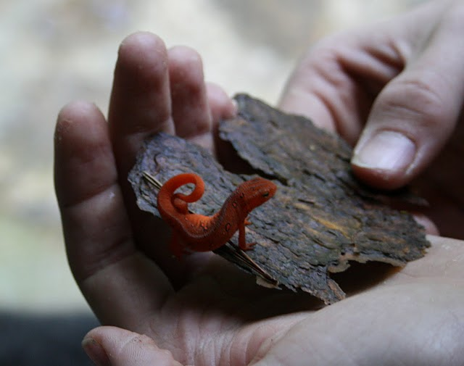
Dimensions of Biodiversity
“an inexact first pass” with focus on key but little known dimensions

